Slide 1


Slide 2
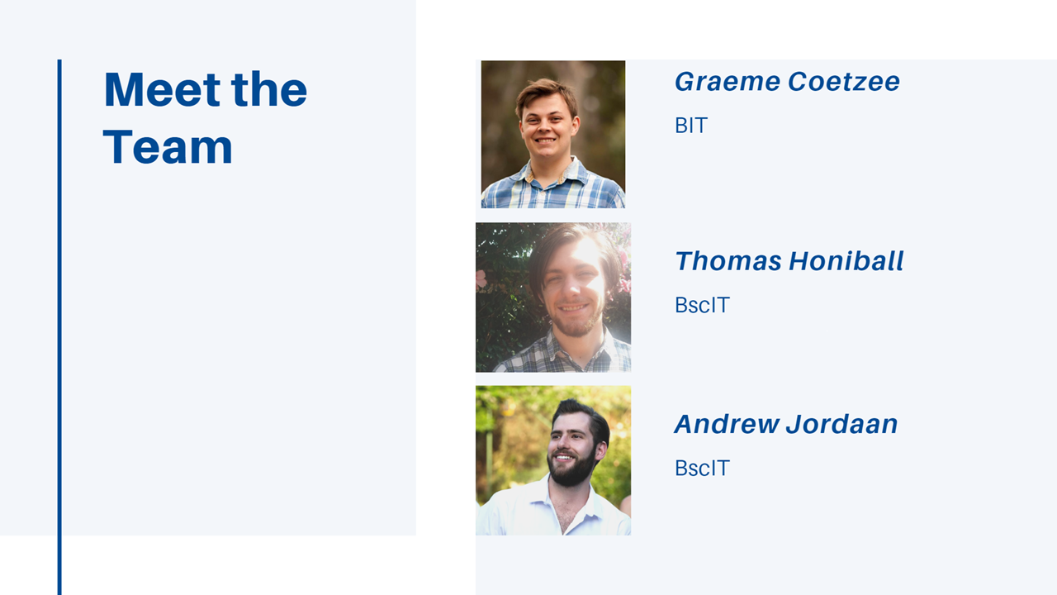

Slide 3
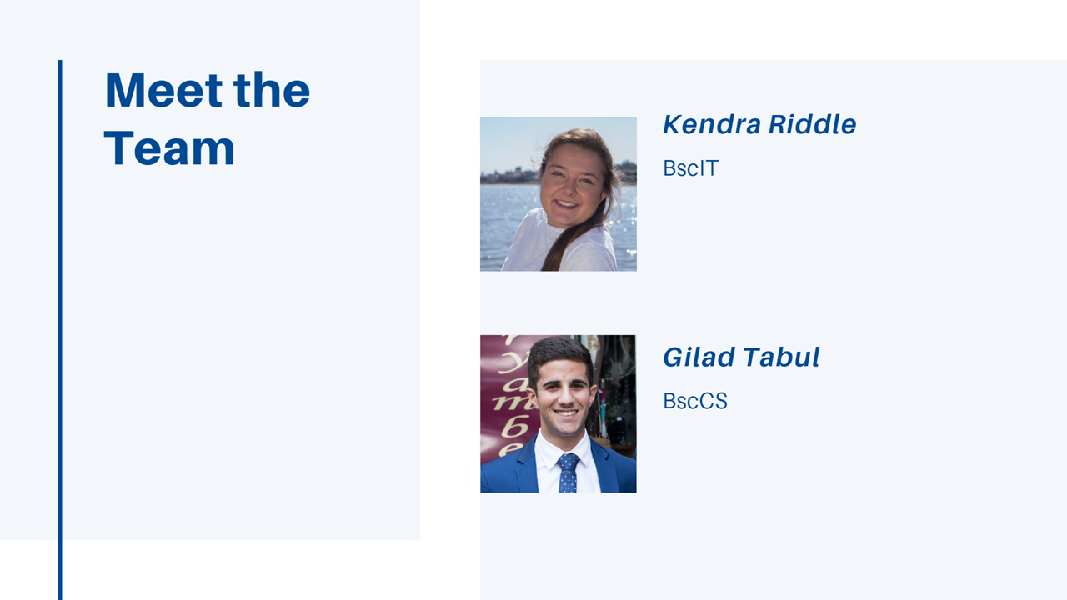

Slide 4
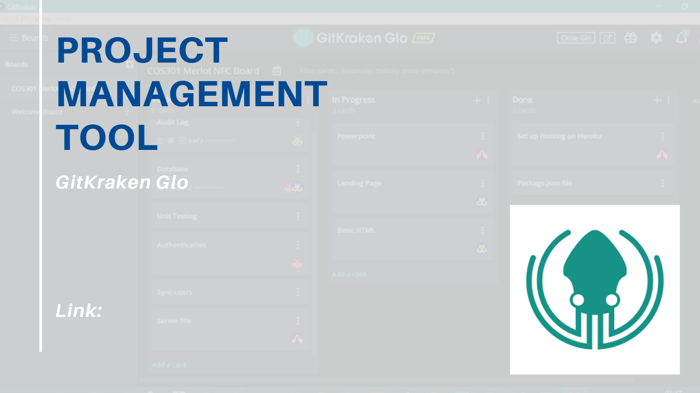
https://app.gitkraken.com/glo/board/XJR4qMaIEAAP9-yr
https://app.gitkraken.com/glo/board/XIkLh8aIEAAP9nlL

Slide 5
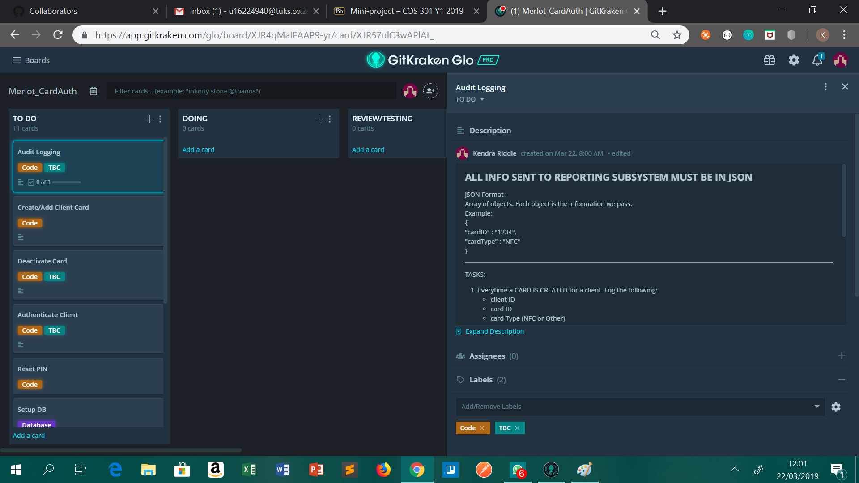

Slide 6
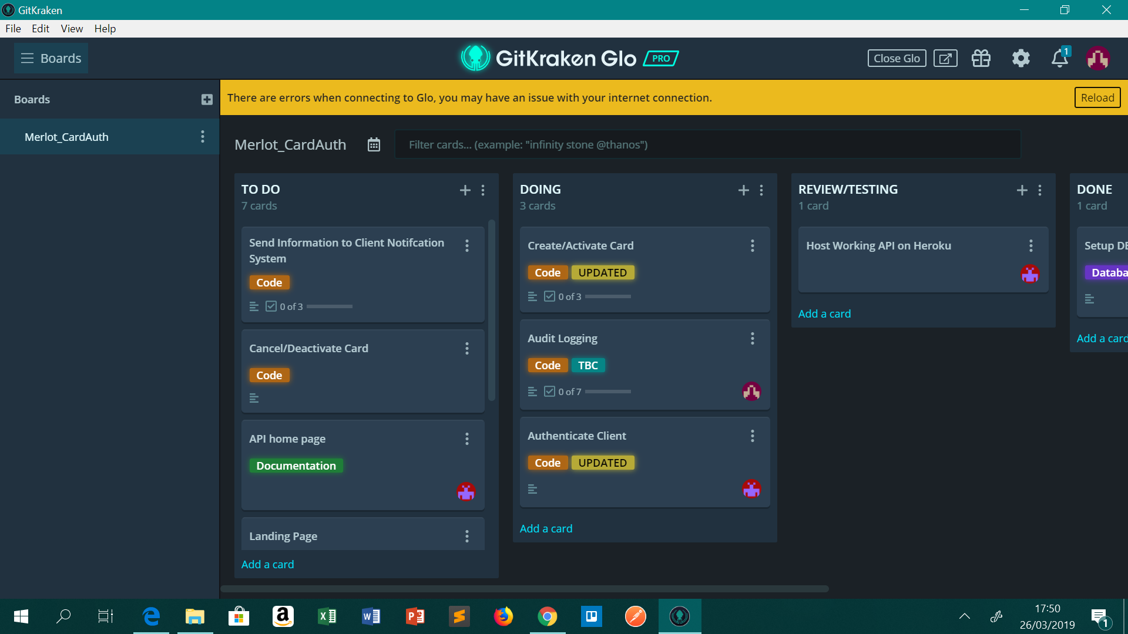

Slide 7
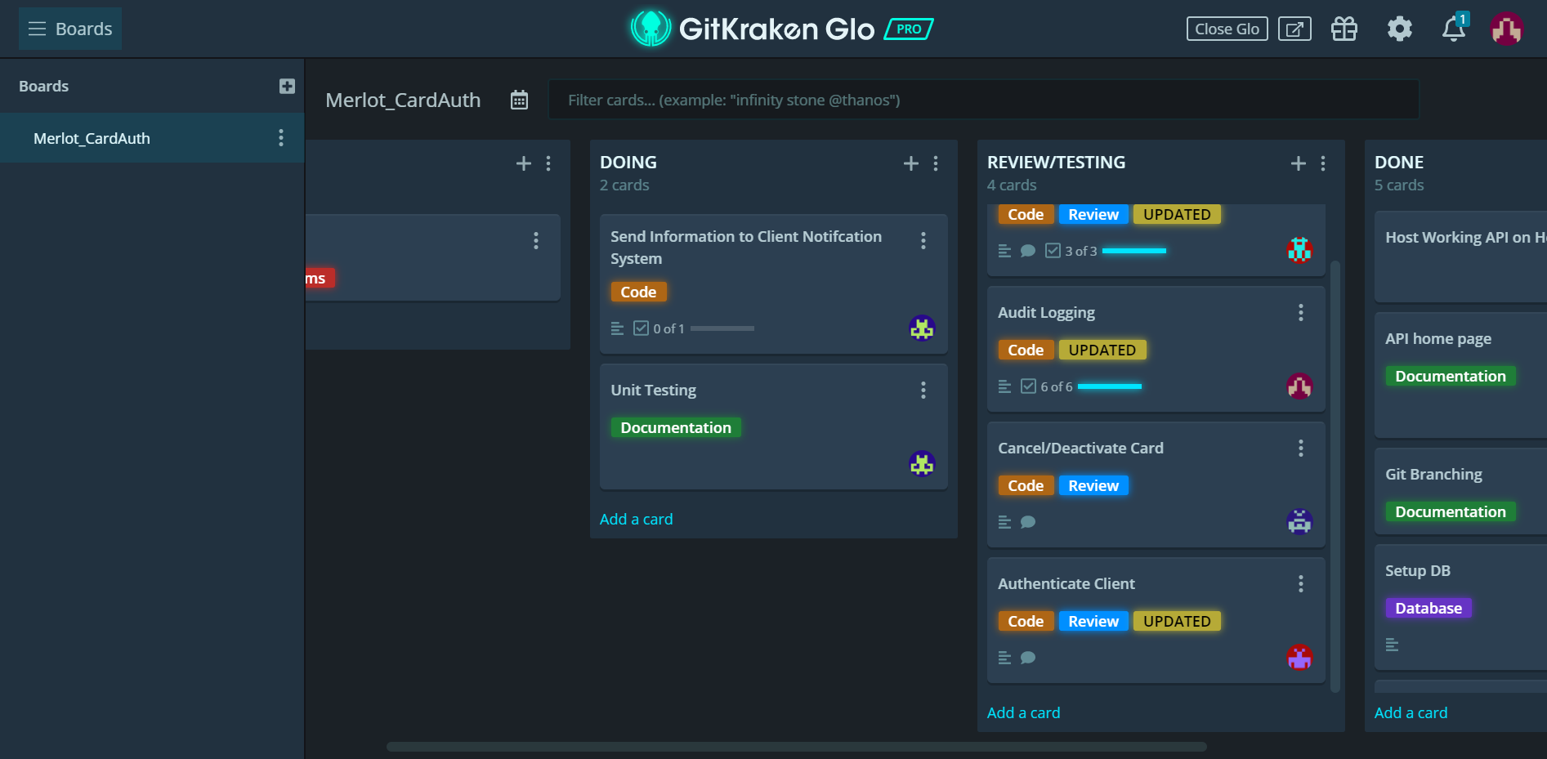

Slide 8

https://dashboard.heroku.com/apps/boiling-reef-24290

Slide 9

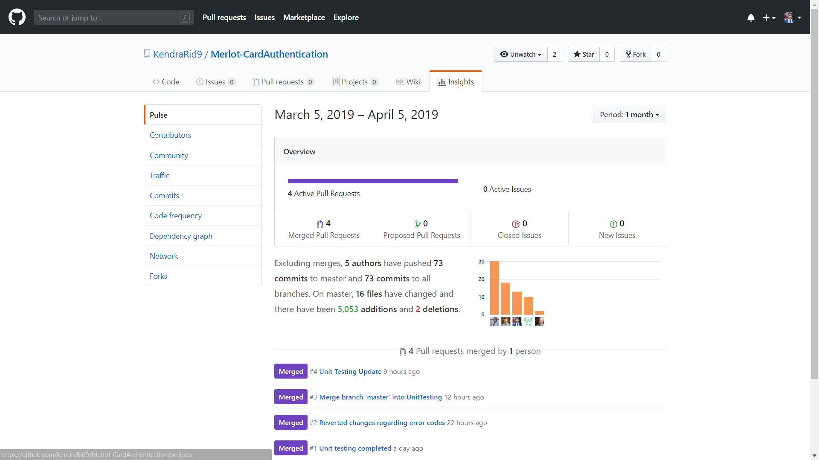

Slide 10
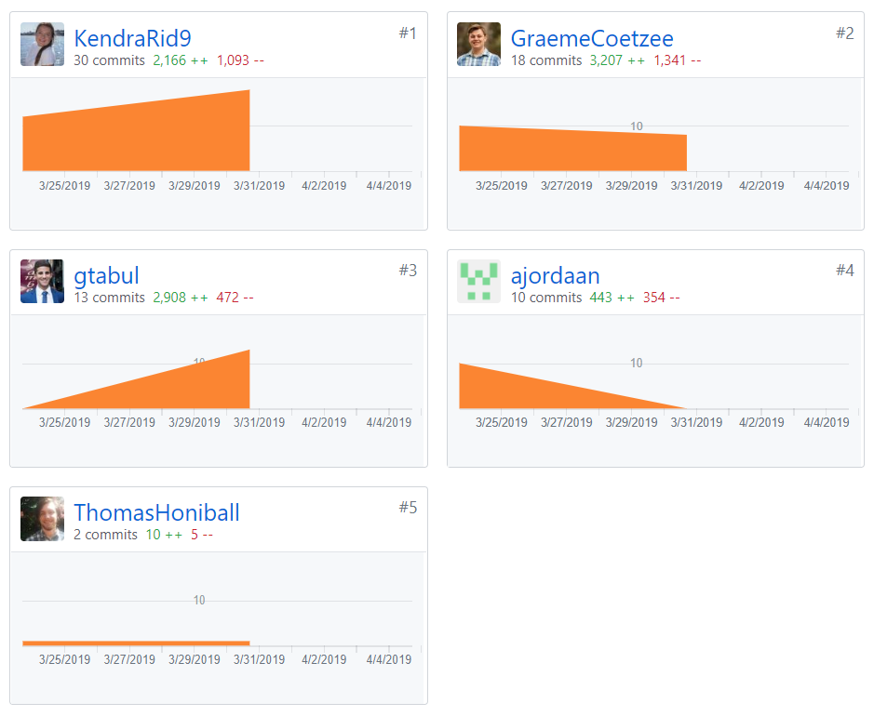

Slide 11
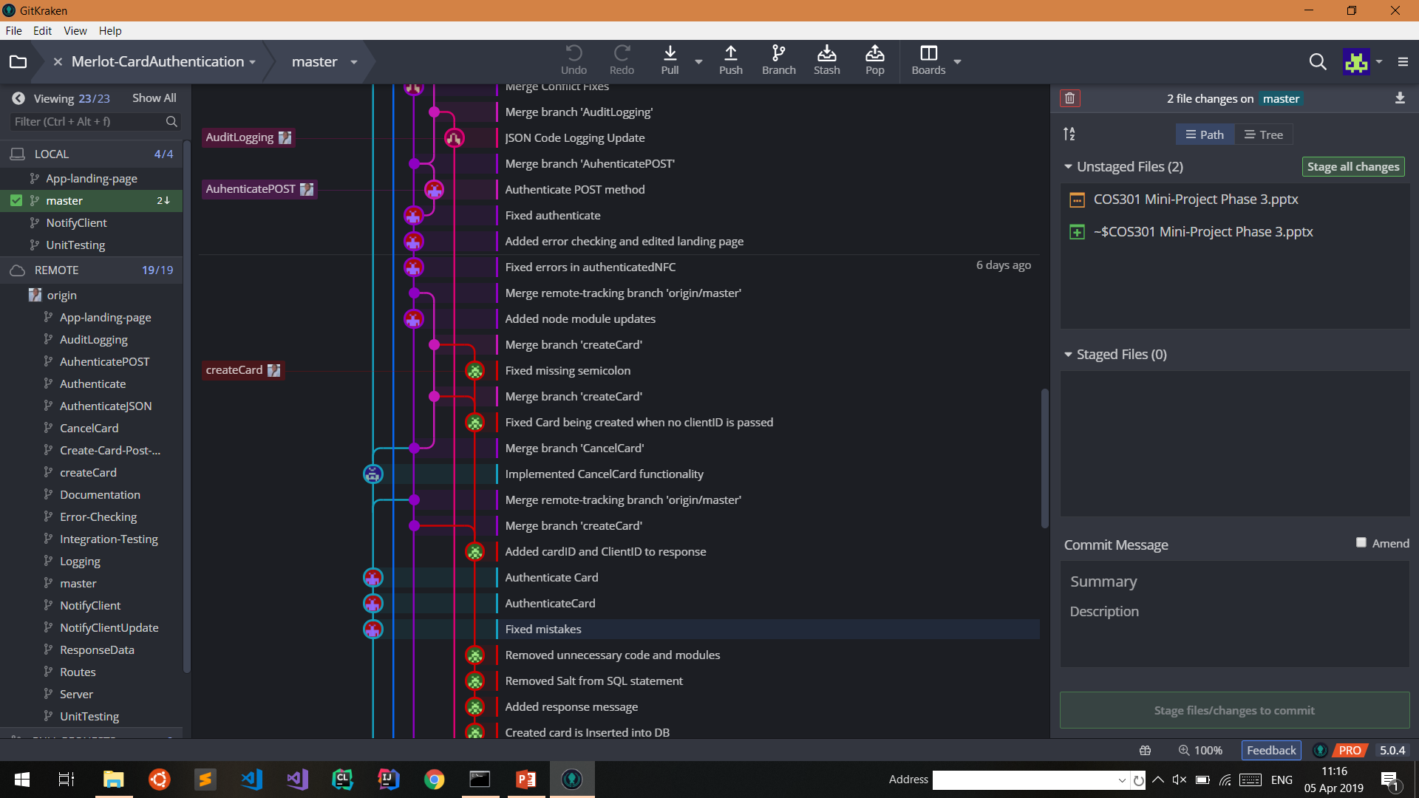

Slide 12
